Slide 1
18ECO134T – Sensors and Transducers
Unit III : Session 1 : SLO 1
SRM Institute of Science and Technology
Notes:
Pl use Font Family : Arial Narrow
To enhance the teacher presentations and the overall comprehension of students, it allows to present their lessons in a more dynamic and effective way. Set a Learning Objective:
1. Write an Outline for Key Ideas
2. Give the Presentation About Education a "Why"
3. Share Techniques and Tips for the Topic
4. Teach With Visualizations
5. Use Animations Carefully

Slide 2
Thermal sensors: Introduction
Thermal sensors measure the change in temperature via the change of electrical properties of sensor materials.
SRM Institute of Science and Technology
Notes:
Pl use Font Family : Arial Narrow

Slide 3
THERMAL SENSORS - INTRODUCTION
Thermal sensors are primarily temperature sensors and their operating principles have long been established, specially those of the primary sensors, also called thermodynamic sensors.
Any physical quantity say Q is usually expressed as its magnitude in number N and in unit U so that
If it is possible to relate temperature T directly in the above form of Eq., from the first principles, in a sensing system, then it is called a primary sensor.
Even though the principles of thermal sensing are well established, newer innovations are added to the stock of sensors dependent on these principles with improved quality and better practical approaches.
Many of the commonly used practical 'thermometers' are, however, not primary in that sense and may be called secondary as the relationship between Q and T used by them is largely empirical.
Primary Thermal Sensor - Measured property of matter is known so well that temperature can be calculated without any unknown quantities.
Secondary Thermal Sensor – Knowledge of measured property is not sufficient to allow direct calculation of temperature.
Q = NU

Slide 4
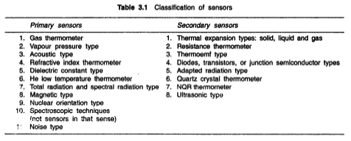
A brief classification of primary and secondary temperature sensors is presented in Table

Slide 5
There are different kinds of heat flux sensors which measure heat flux in terms of temperature difference.
Even in temperature measurement. there are special types of sensors such as pneumatic type, pyroelectric type and so on.
The following discussion describes the primary sensors. perhaps, in principles alone, mainly because of their limited applications in industry.
Some of these are transformed to or adapted in commercial applications with minor changes. The overall measuring systems are not discussed but the basic sensing mechanisms are dealt with greater emphasis.
https://www.youtube.com/watch?v=9JuKqkZVgTU

Slide 6
PNEUMATIC TEMPERATURE SENSOR:
A pneumatic temperature transmitter with a sensor of liquid fill or gas fill operates based on the force balance principle.
Thermal expansion of gas or liquid inside the capillary and bulb produces a 3-15 output signal proportional to the measured temperature.
It is functionally similar to a proportional controller.
PYROELECTRIC TEMPERATURE SENSOR:
Pyroelectricity (from the two Greek words pyr meaning fire, and electricity) is a property of certain crystals which are naturally electrically polarized and as a result contain large electric fields.
Pyroelectricity can be described as the ability of certain materials to generate a temporary voltage when they are heated or cooled.
The change in temperature modifies the positions of the atoms slightly within the crystal structure, such that the polarization of the material changes.
This polarization change gives rise to a voltage across the crystal. If the temperature stays constant at its new value, the pyroelectric voltage gradually disappears due to leakage current.

Slide 7
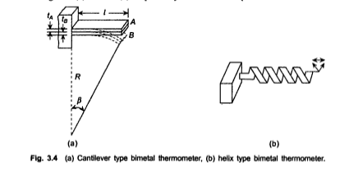
THERMAL EXPANSION TYPE THERMOMETRIC SENSORS
The thermal expansion types thermometric sensors are, perhaps. the oldest varieties still used commercially to a certain extent.
Earliest of this kind is the solid expansion type bimetallic sensor which uses the difference in thermal expansion coefficients of different metals.
Two metal strips A and B of thickness t_{A} and t_{B} and thermal expansion coefficients α_{A} and α_{B} are firmly bonded together at a temperature, usually the lowest or the reference temperature, to form a cantilever or a helix with one end fixed as shown in Figs 3.4(a) and 3.4(b) respectively.

Slide 8
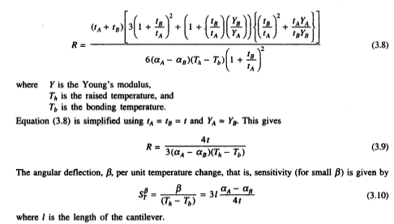
When the temperature of the cantilever or the helix is raised by heating or lowered by cooling. one strip expands or contracts more and free end of either of the two moves as shown.
The cantilever, in fact, bends into a circular arc with radius of curvature R given by the relation

Slide 9
increases linearly with length and inversely with strip thickness for a given pair of metal elements. Usually element B is made of invar (a Ni-Fe alloy) of α_{B} 1.7 x 10⁻⁶/°C which is quite low and element A is brass or steel of different alloying compositions. Such sensors can work precisely but not very accurately in a range -50-400°C.
Besides cantilever and helix forms, they are also made in spiral and disc forms in different control applications.
Next in line is the liquid-in-glass thermometer—the liquid in majority of the cases being mercury. With mercury, this thermometer is almost the basic temperature measuring unit in home (as clinical thermometer), in laboratories and even in industries.
It utilizes the expansion property of the liquid kept in a bulb to which a capillary, closed at the far end, is attached through which the expanded liquid rises and an indication in mm, calibrated directly in temperature scale, is obtained.

Slide 10
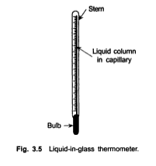
The schematic is shown in Fig. 3.5 The range of mercury thermometer is normally -35-300°C and the upper limit is 357°C. its boiling point.
The range can be extended upto 600°C by filling the volume above mercury with pressurized dry nitrogen.
The volume of the bulb is made 100 to 400 times larger than the capillary volume. Other liquids used as expansion media are given in Table 3.3 with their corresponding ranges.

Slide 11
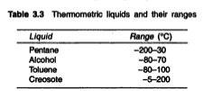
When the measurement is made, the thermometer should be immersed upto the meniscus in the capillary which means that the thermometer is to be moved for varying temperatures.
Alternatively, the entire thermometer is immersed, or, only the bulb is immersed. The last alternative is the most common one and for this purpose. a correction has to be applied for the mercury column above the immersion line because the column is at a different temperature t_{c} than the measured value t_{m.}

Slide 12

The correction term is
An extension of this is the industrial type liquid filled-in system which consists of a metallic bulb attached to a metallic capillary. The other end of capillary is fitted with a Bourdon. The expansion of the liquid in the bulb is transmitted to the Bourdon which uncurls in the usual manner.
The basic scheme is similar to that presented in Fig. 3.1. A number of compensations are necessary to obtain correct indication by the measurement system using such a sensor.
The correction methods are available in standard texts on industrial instrumentation.

